Slide 1
SWD - Pattern Hand In Memento Pattern
Group 1:
Mikkel Overgaard, Tobias Henriksen
Jacob Kurtzhals, Flemming Lundahl

Slide 2
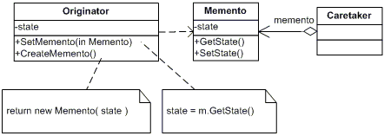
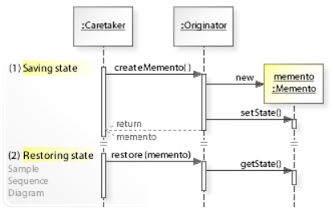
The Memento Pattern
What is the Memento Pattern?
Pros and cons?
Pros
Reusable
Does not violate capsulation
Easy to implement rollback functionality
Cons
Not very used
Can often be exchanged for another pattern

Slide 3
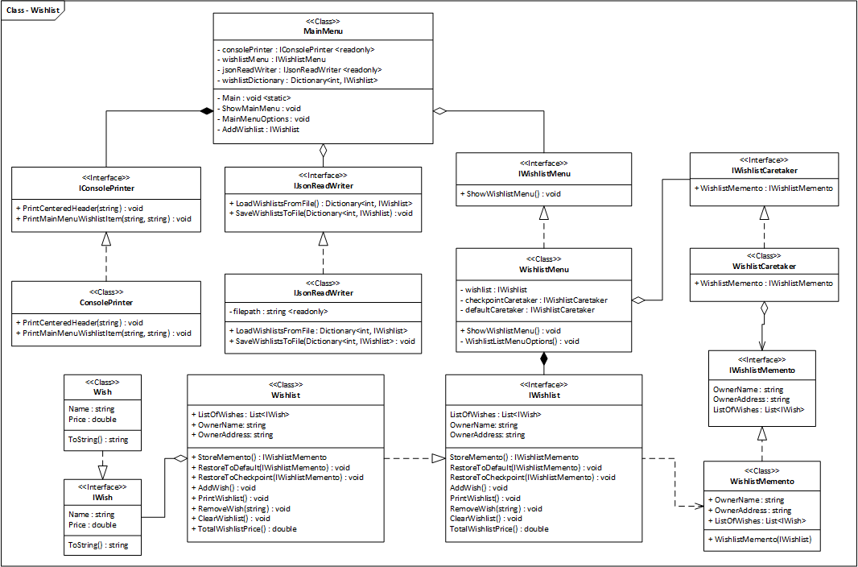
Our Memento Pattern

Slide 4
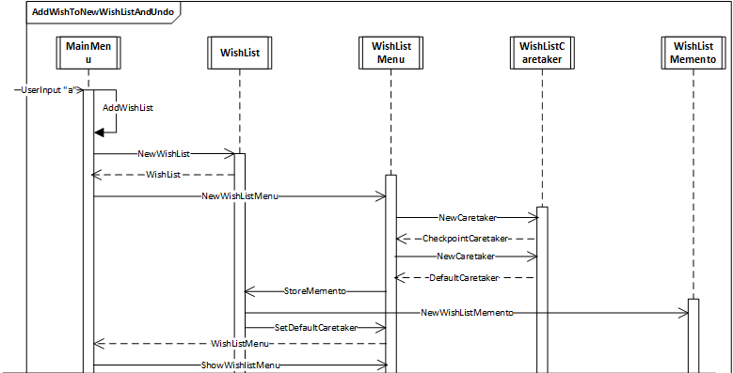
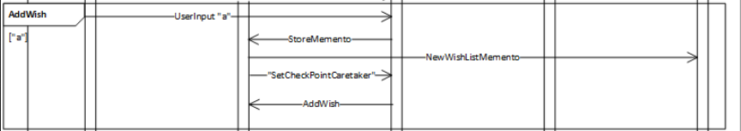
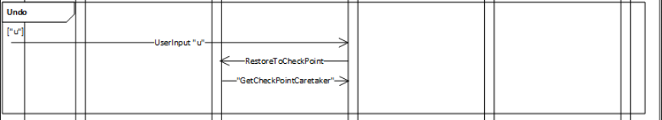
Sequence Diagram
Add wish
Undo last change

Slide 5
Reflection
Conclusion
&
Encountered issues
Finding a problem to solve with Memento
Similar patterns
Command
Conclusion
Very useful for lightweight programs
Easy to implemement and reuse for rollback functionality

